Slide 1

Analysis of COVID 19 Effects on the World
Tan Wen Tao Bryan (p2214449) Ryan Yeo (p2214452)
Ethan Jedidiah Pang Kin Fong(p2214241) Zachary Leong (p2201861)

Slide 2
Introduction
Topic of Interests:
Number of COVID 19 Cases, Number of Deaths, COVID 19 Policies (ex. School Closures, Masks Policies)
Objectives:
Observe how COVID 19 affected the world in terms of number of people infected, deaths and hospital admissions
Observe how government policies are impacted by the rate of COVID 19 infection for different continents

Slide 3
Nature of Merged Dataset
COVID 19 Cases & Deaths | Masks Policies | School Closures
Size of Dataset: 29 columns x 176834 rows
Data Fields: location, date, new cases, new deaths, reproduction rate, icu patients, hosp patients weekly, icu admissions weekly, hosp admissions, new tests, positive rate, tests per case, people vaccinated, people fully vaccinated, total boosters, new vaccinations, new vaccinations smoothed, new people vaccinated smoothed, stringency index, population density, median age, gdp per capita, extreme poverty, cardiovasc death rate, handwashing facilities, human development index, facial coverings, school closures
Stringency Index: Shows the strictness of 'lockdown style' policies that primarily restrict people's behaviour.
Facial Coverings (0-4) & School Closures (0-3): Strictness level of policies
Hospital Admissions: Total number of people that got admitted into hospitals

Slide 4
Cleaning Datasets (Excel)
Replace missing or null values with 0
Use Pivot table to check if there are duplicate data category with different naming format
Change date format from US(MM/DD/YYYY) to SG(DD/MM/YYYY)
Drop unused columns ex. cumulative, smoothed data and other useless unused data such as hospital beds, diabetes prevalence, excess mortality
Replace '_' in column fields with ' '

Slide 5
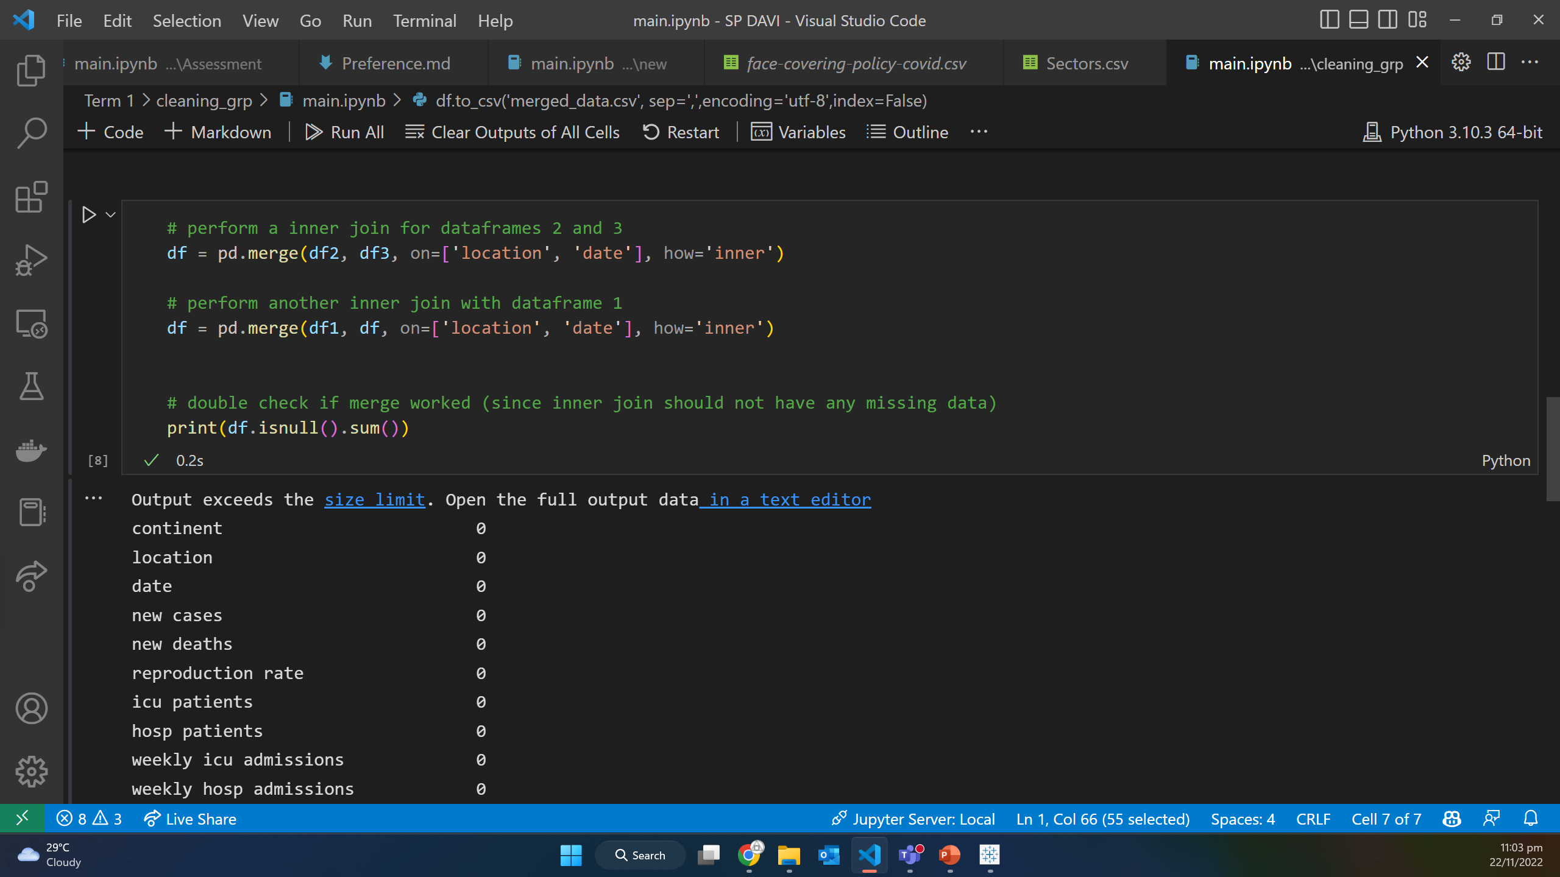
Cleaning Datasets (Pandas)
Perform an inner merge on all three covid datasets to form a merged dataset

Slide 6
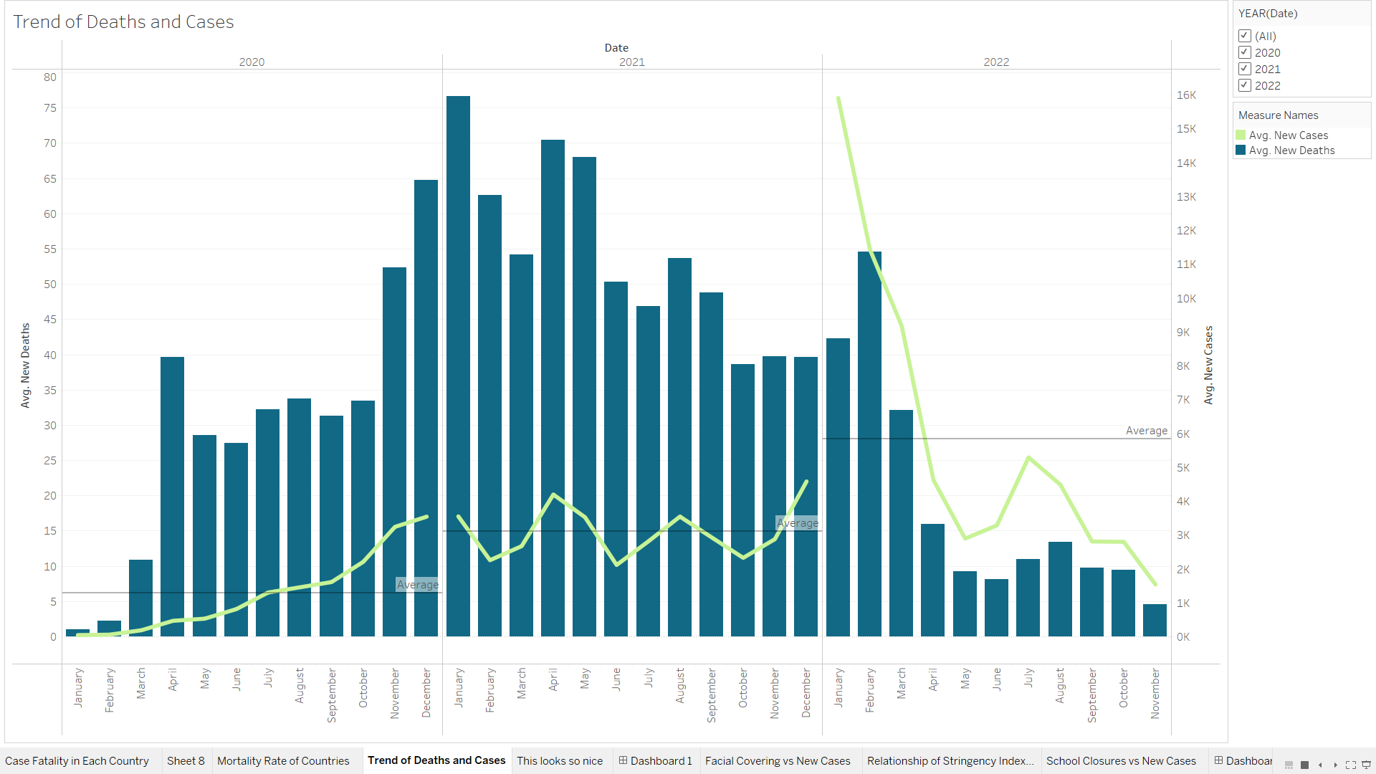
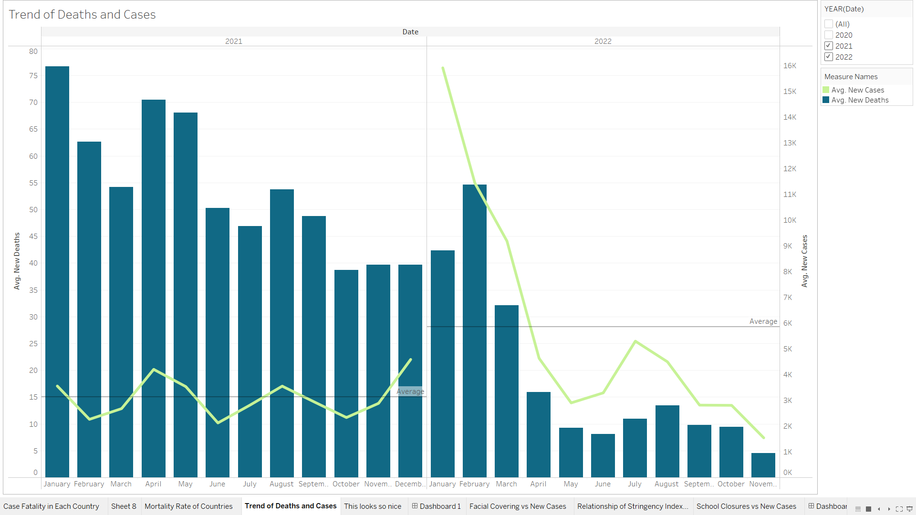
Peak of Deaths Happened in Jan and Feb 2021 /22
At first glance, we notice a spike in the number of deaths in January for both 2021 and 2022.
Overall, 2021 has the most deaths while 2022 has the most cases.
In 2022, the number of cases were above its average value in the earlier months and below average in the later months as it was slowly improving.
In 2020, the number of cases were below its average value in the earlier months and above average in the later months as infected cases started growing.

Slide 7
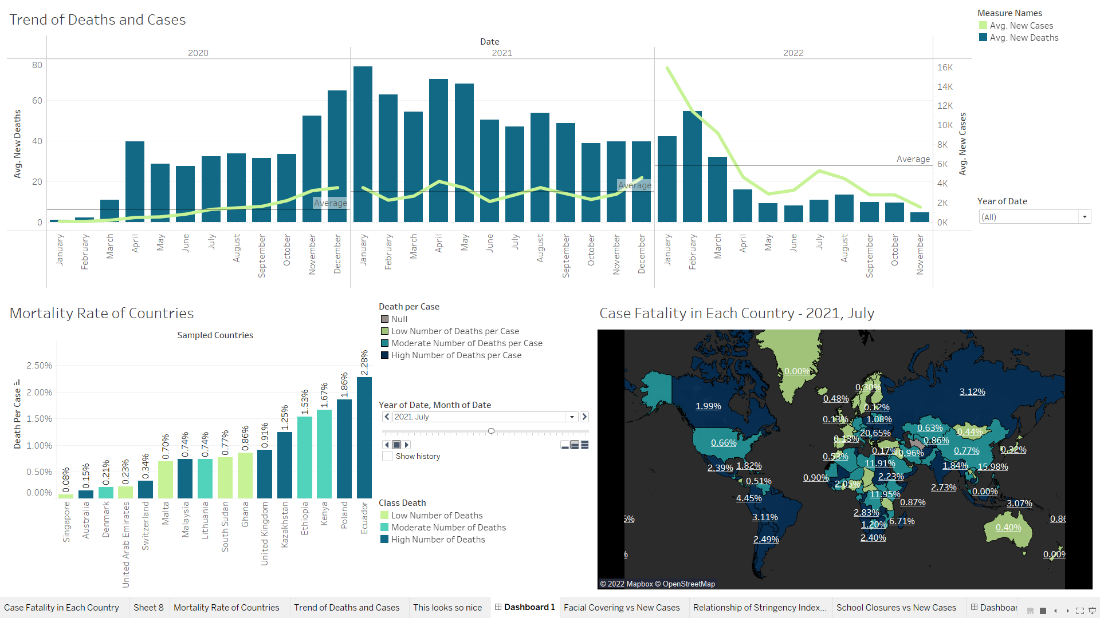
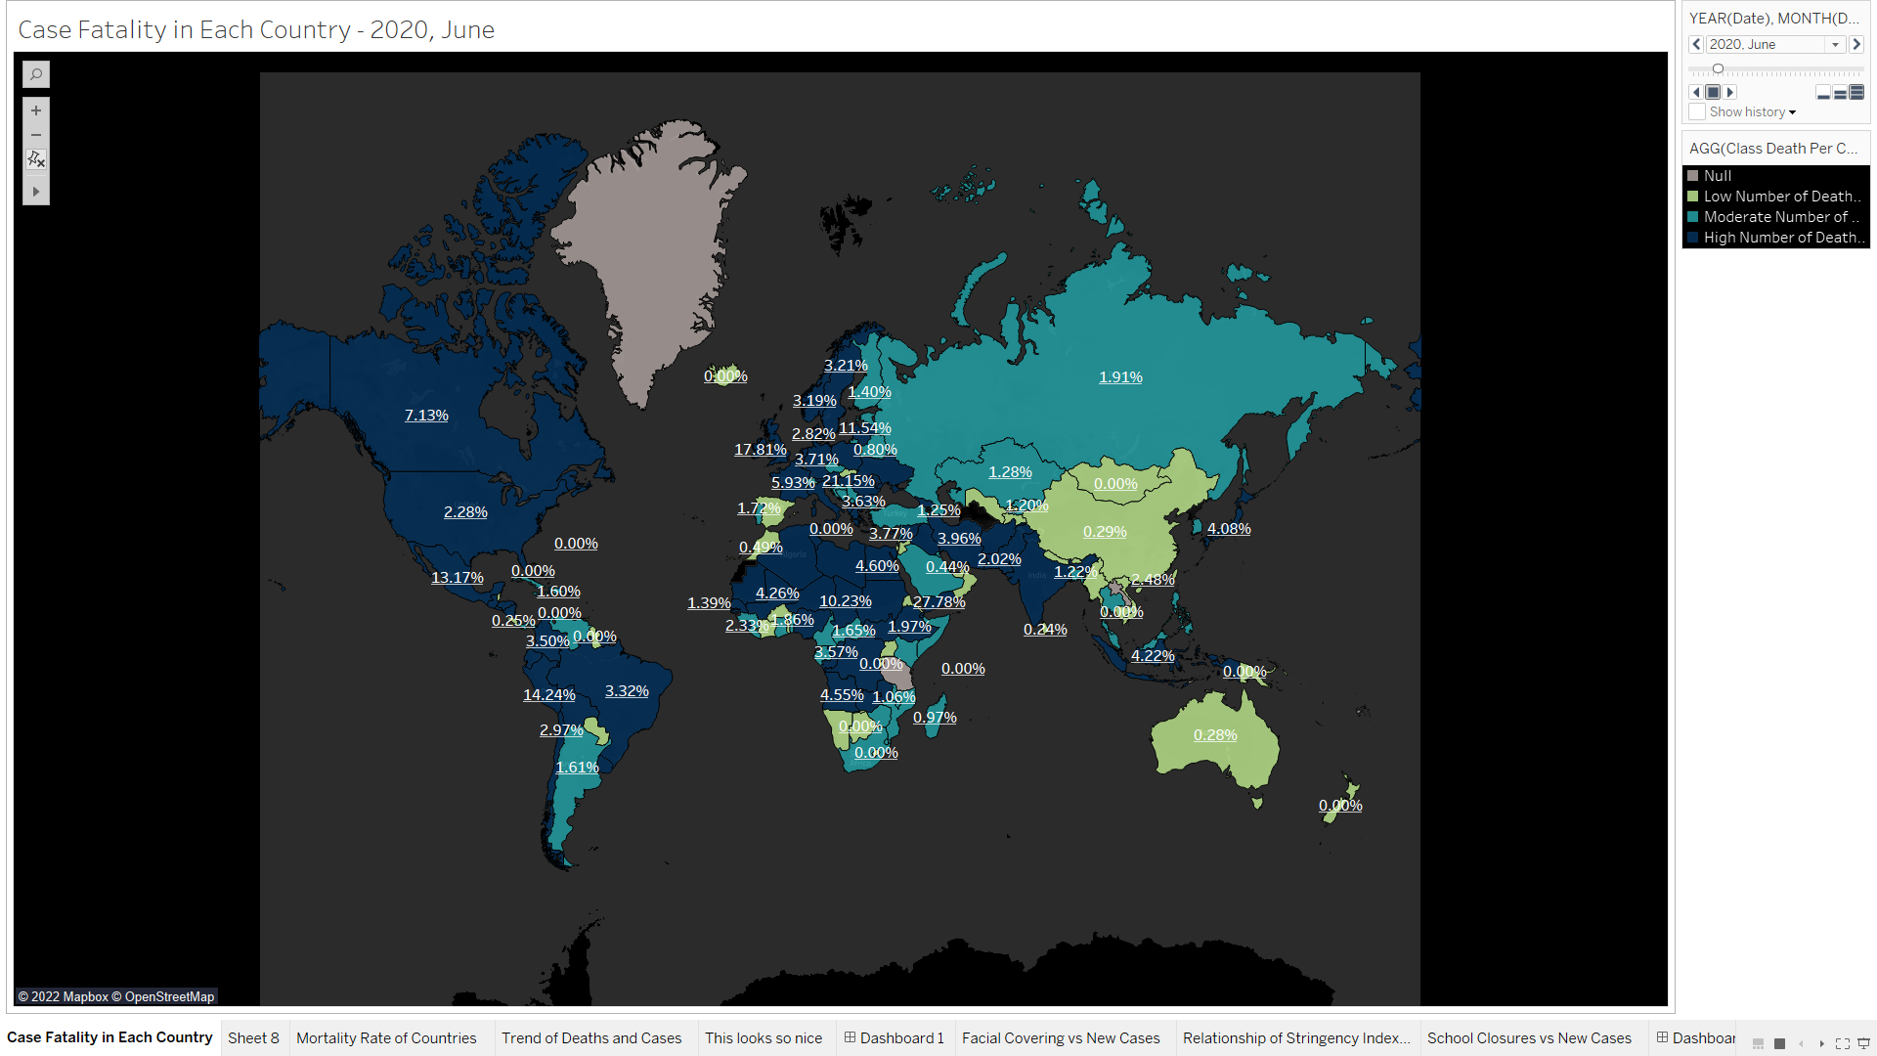
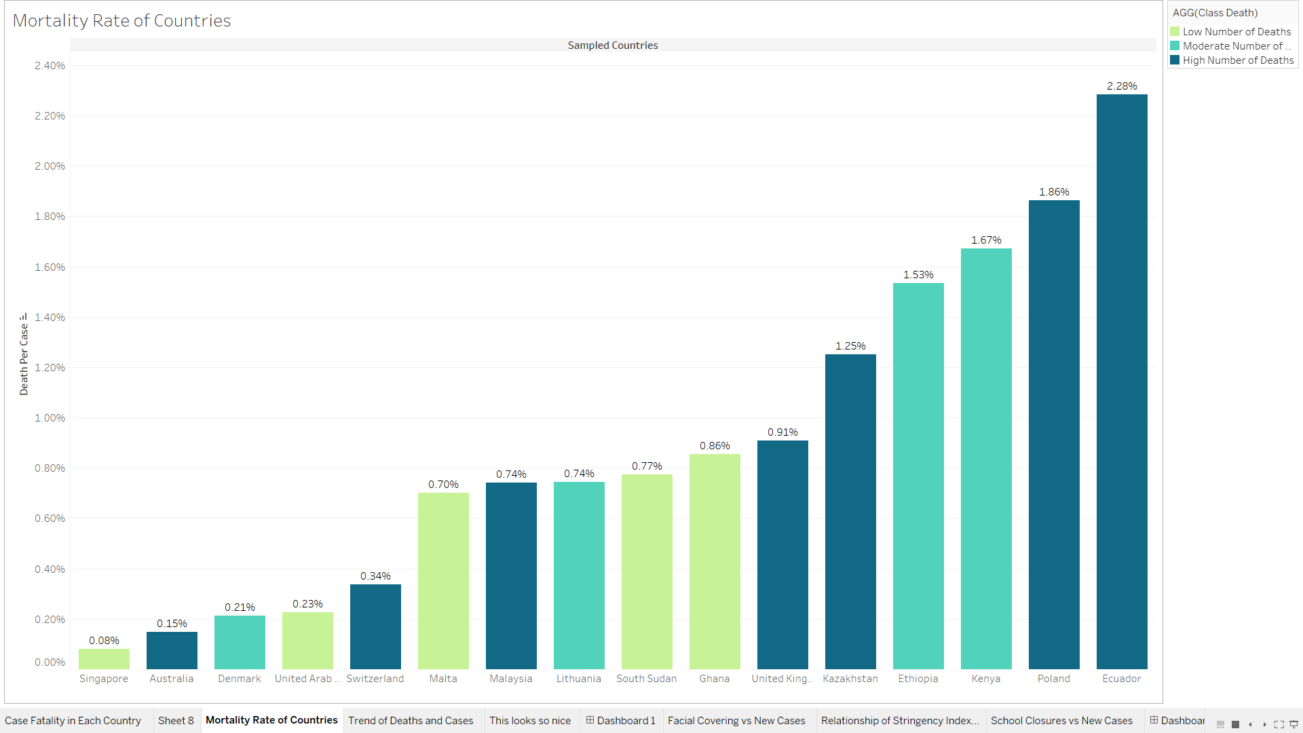
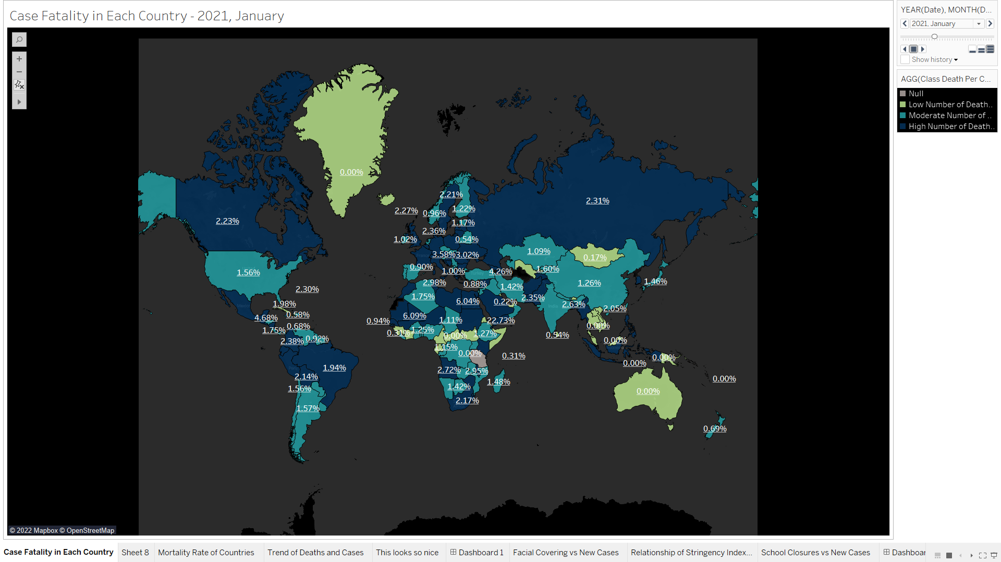
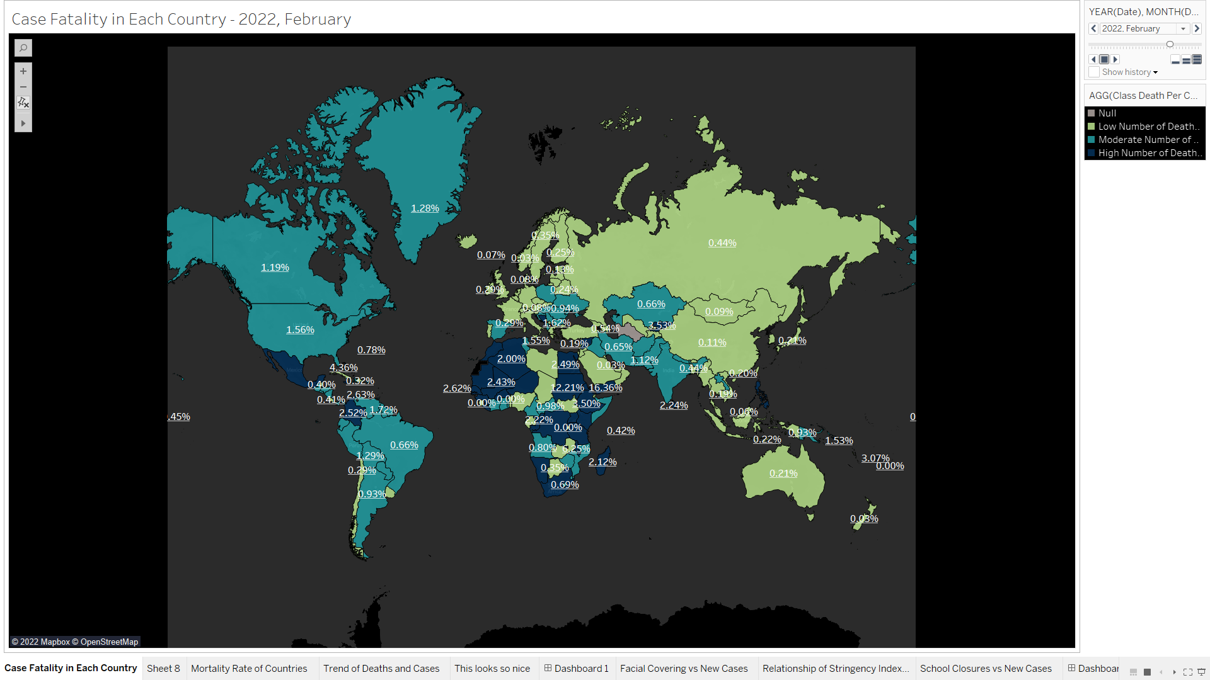
Singapore Has One of the Lowest Mortality Rate
2020: Peak of Covid
Compared to 15 random countries, Singapore has the lowest mortality rate.
In addition, Singapore has a significant lower number of deaths than the other countries.
In 2020 & 2021, the larger countries generally have a higher mortality rate and improved subsequently in late 2022, with Russia as one of the more obvious exceptions.
In the middle of 2020, there was a significantly higher mortality rate throughout the world compared to the other periods.
2022
2020
2021

Slide 8
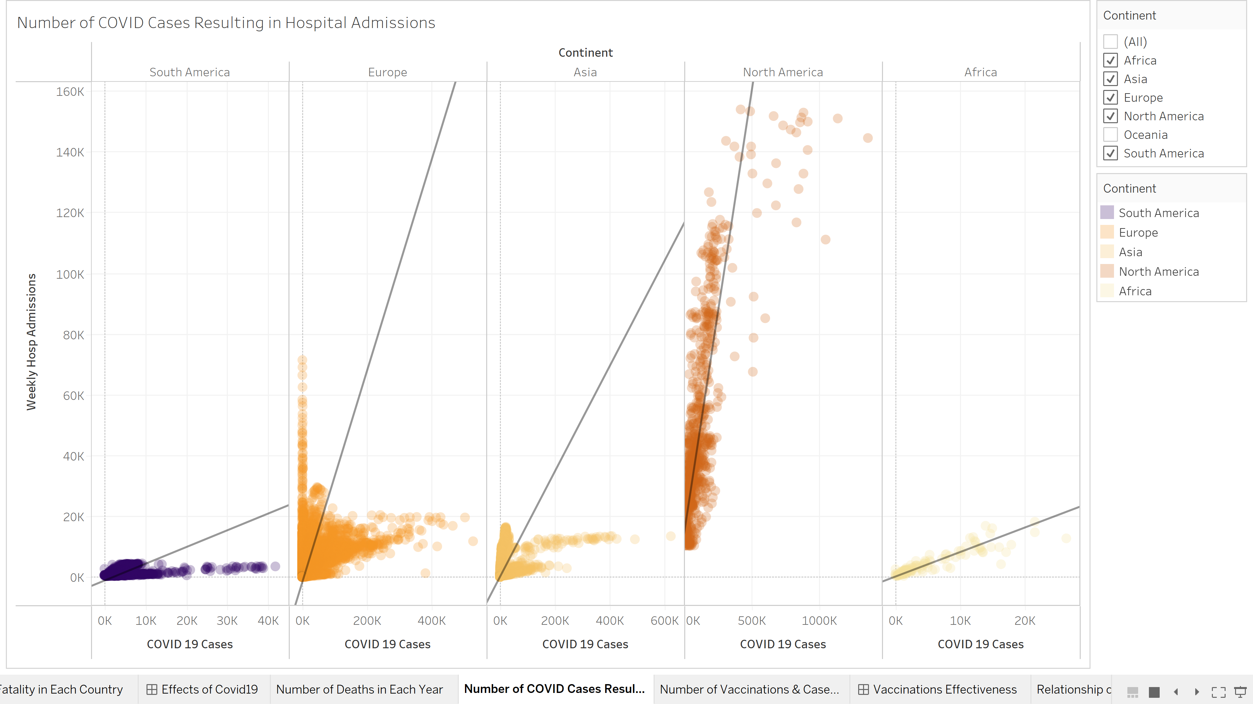
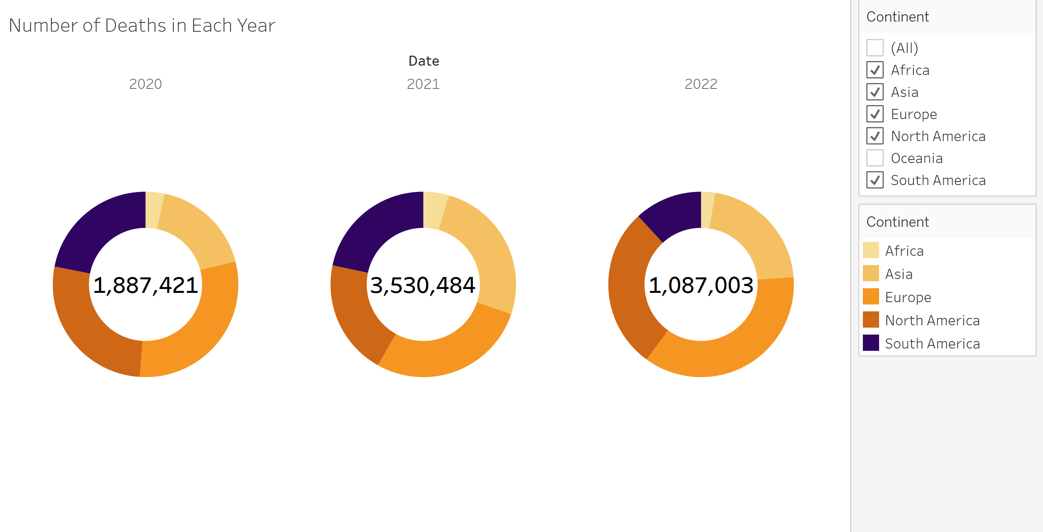
North America Has Highest Number of COVID 19 Cases
2021 has the largest total number of deaths out of the 3 years, nearly twice the number of deaths in 2020.
Africa has the least number of deaths among the continents while Europe has the greatest number of deaths.
Ironically, Africa has the strongest, positive linear relationship between COVID 19 cases & weekly hospital admissions. It could be caused by the lower weekly hospital admissions and COVID 19 cases compared to the other continents.
North America has some outliers which causes it to have the highest number of COVID 19 cases that occurred and weekly hospital admissions.

Slide 9
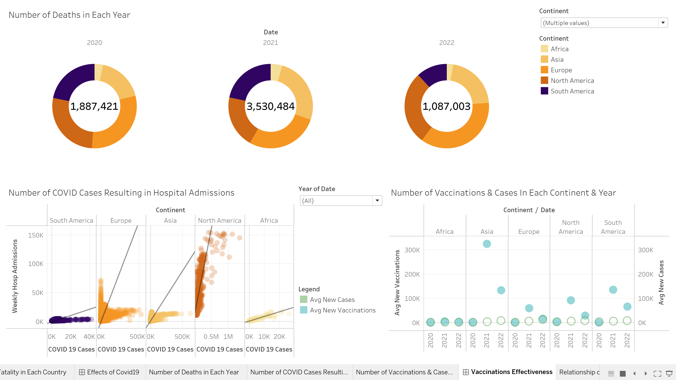
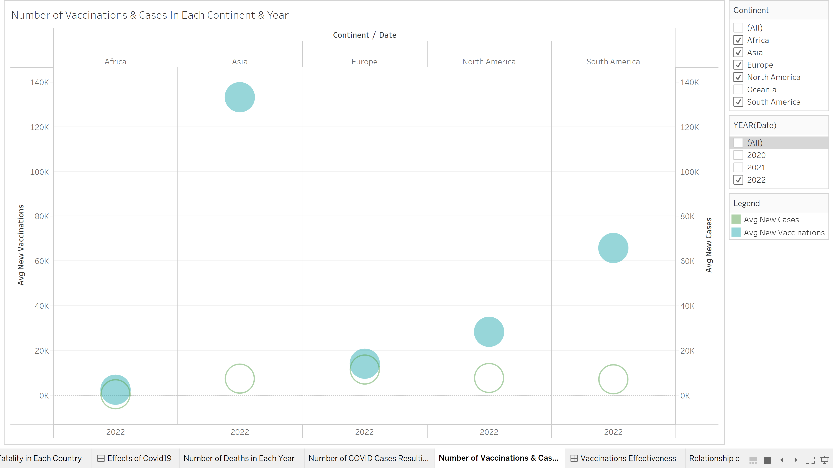
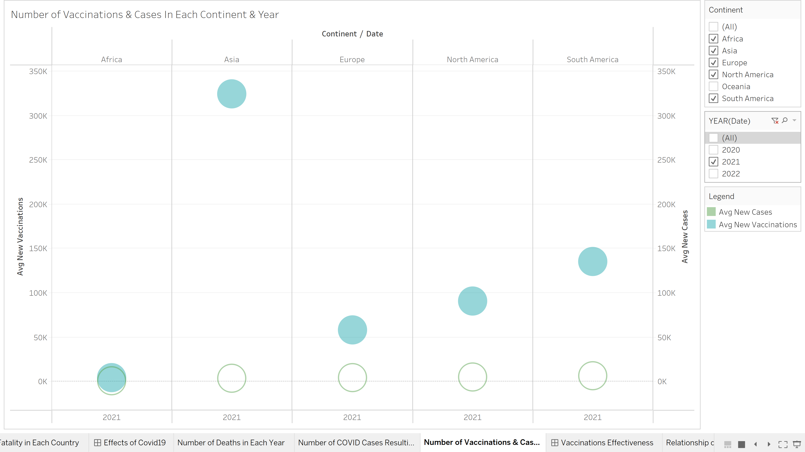
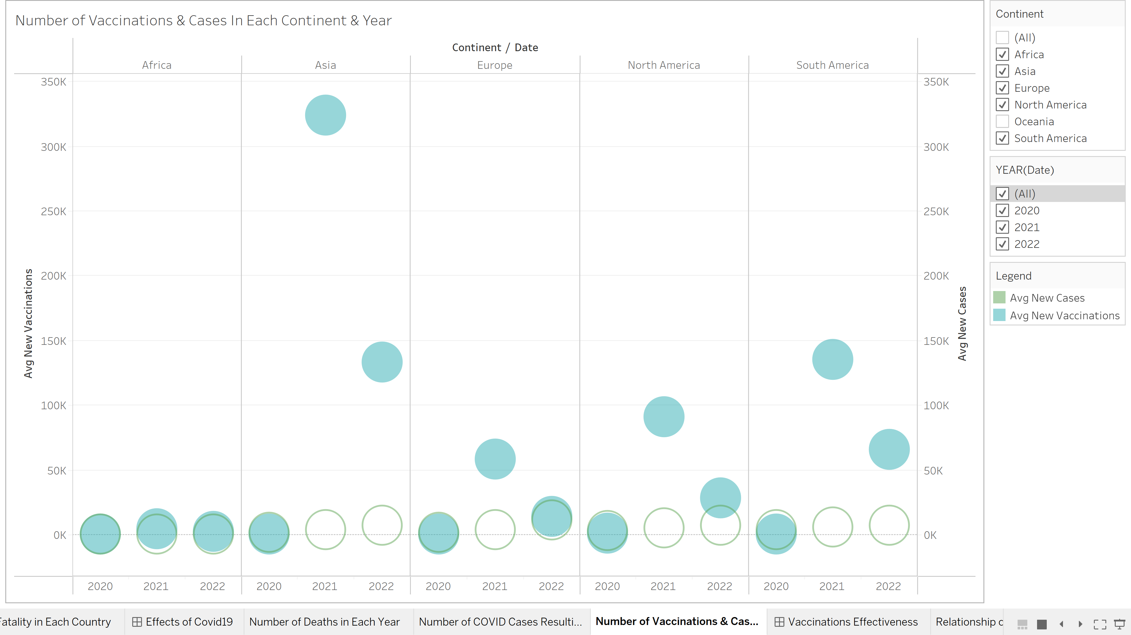
Asia Has the Largest Number of Vaccinations in 2021
Overall, 2021 was the year that has the greatest number of vaccinations while 2020 was the year with the least vaccinations as vaccines were not introduced to the public yet.
In 2021, Asia had the largest number of vaccinations, resulting in the continent with the least average number of COVID 19 cases.
In 2022, Europe has the highest number of COVID 19 cases caused by its low number of vaccinations.
Africa number of COVID 19 cases remain low even with the lowest vaccinations. It could be caused by their high temperature in the continents which decreases the rate of COVID 19 cases, as well as the people adhering to the policies there.
2022
2021
ALL

Slide 10
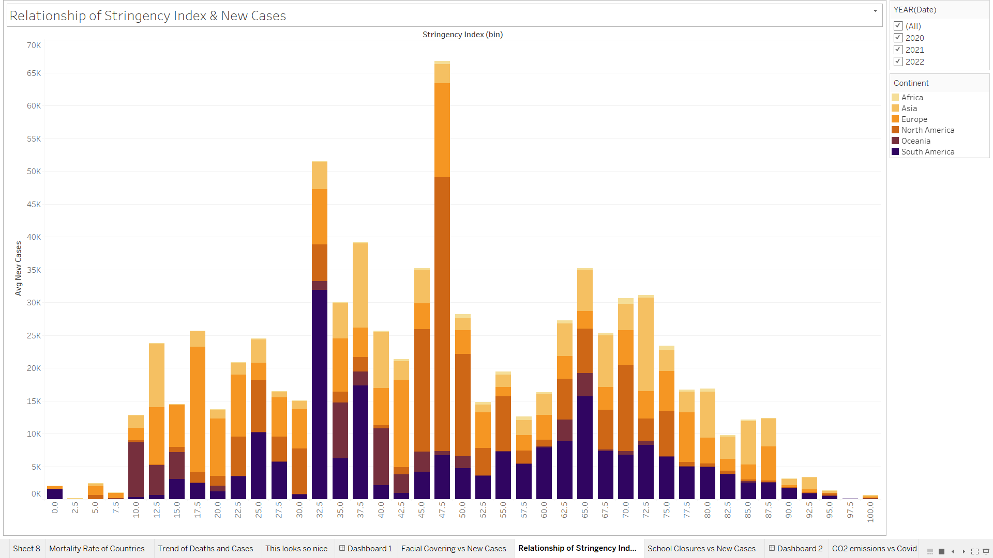
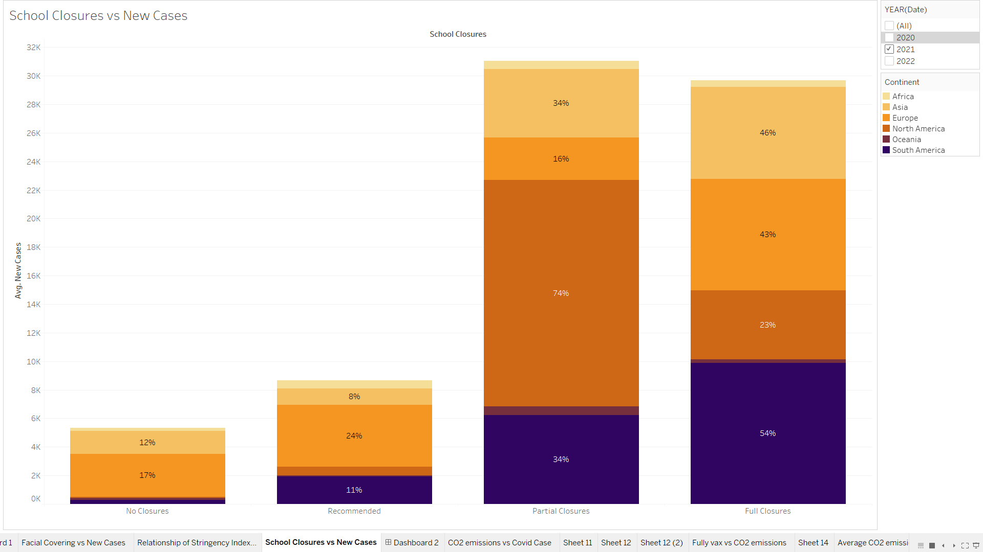
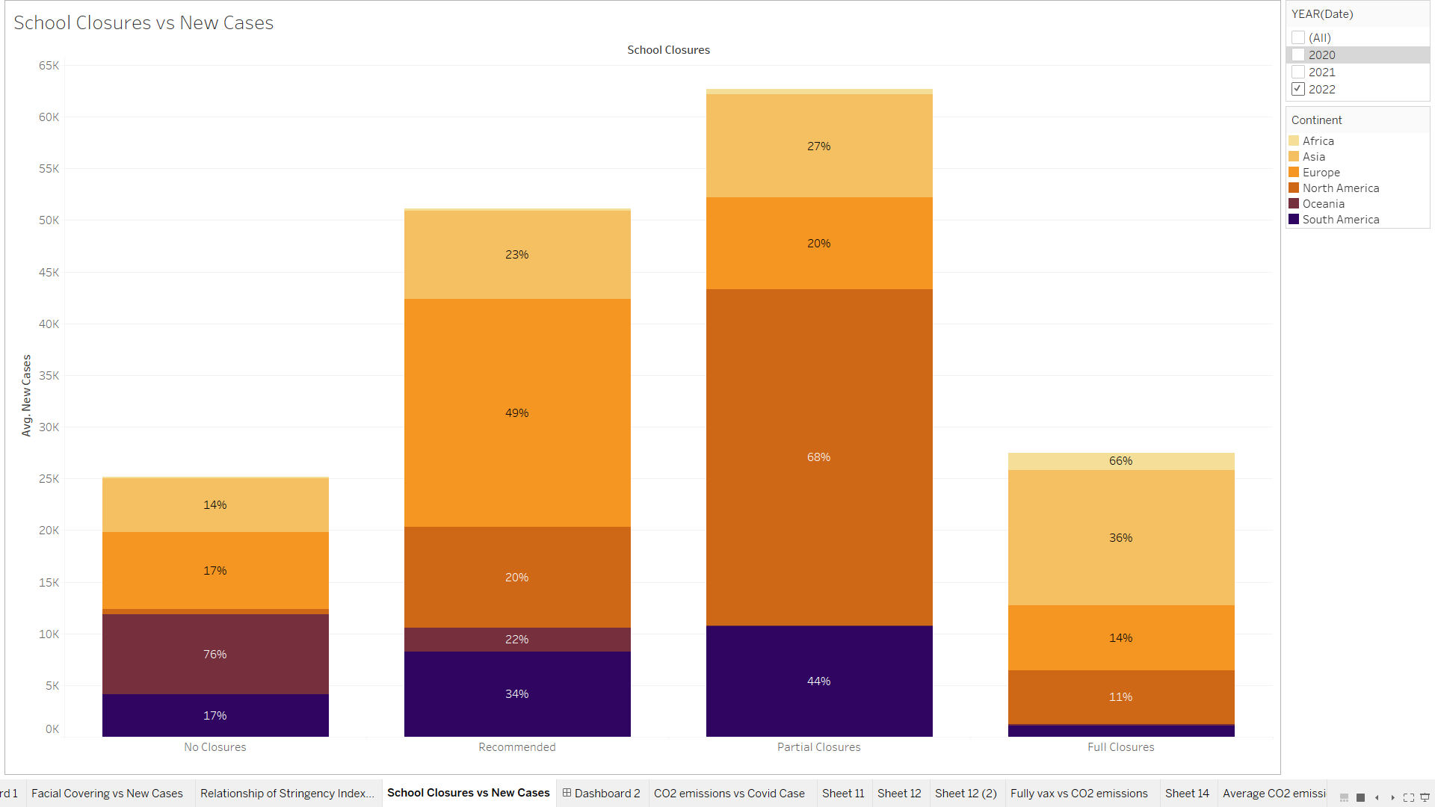
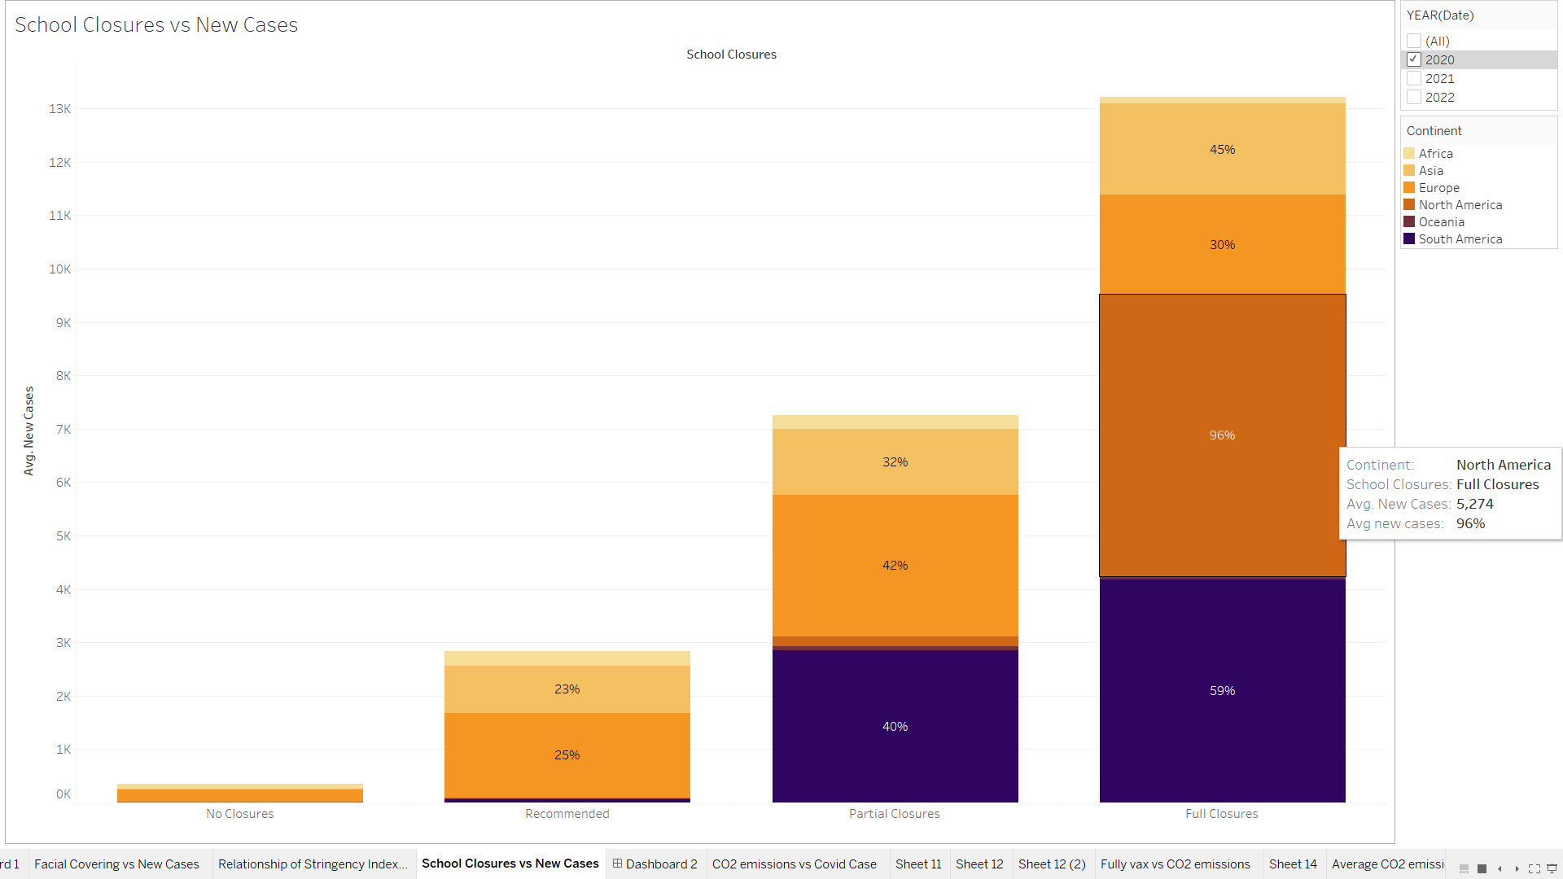
Both Ends of Stringency Index Have Lower Cases
2020 & 2021 have Highest Full School Closures
Countries with stringency index at both ends have a lower number of cases.
Countries have a lower stringency index was due to their lower number of cases while countries with higher stringency index resulted in their lower number of cases.
Higher number of cases are clustered around continents with a moderate stringency index like North America.
2020 and 2021 had more full and partial school closures whereas 2022 had fewer full school closures due to the COVID 19 cases.
North America is the continent with the most school closures.
2022
2020
2021

Slide 11
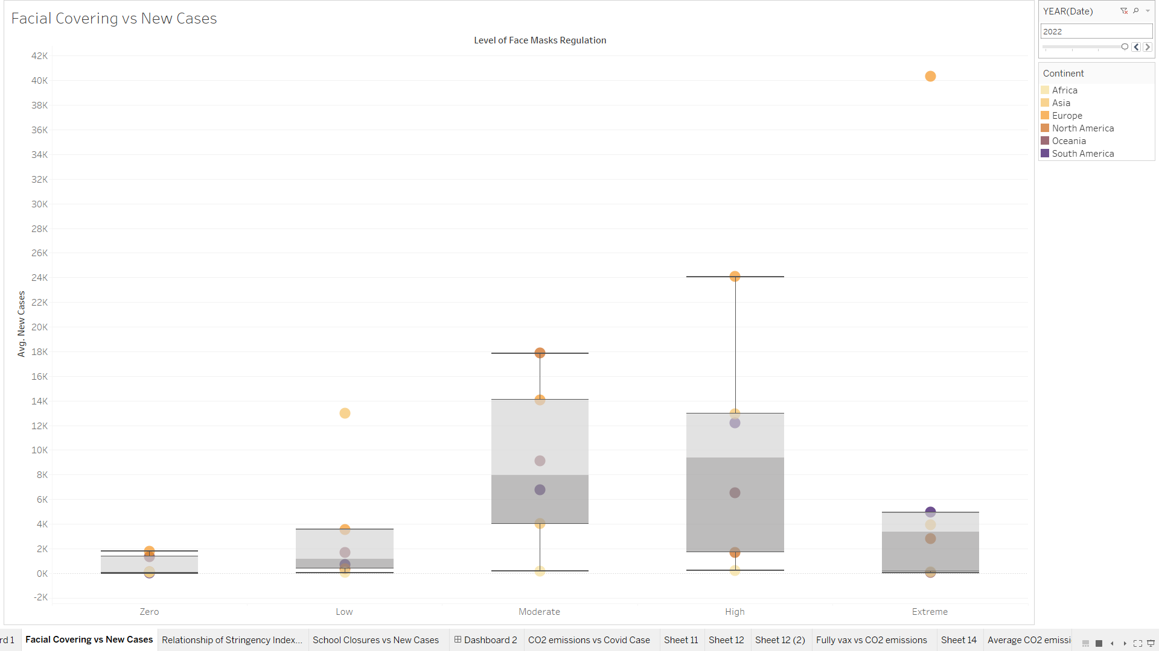
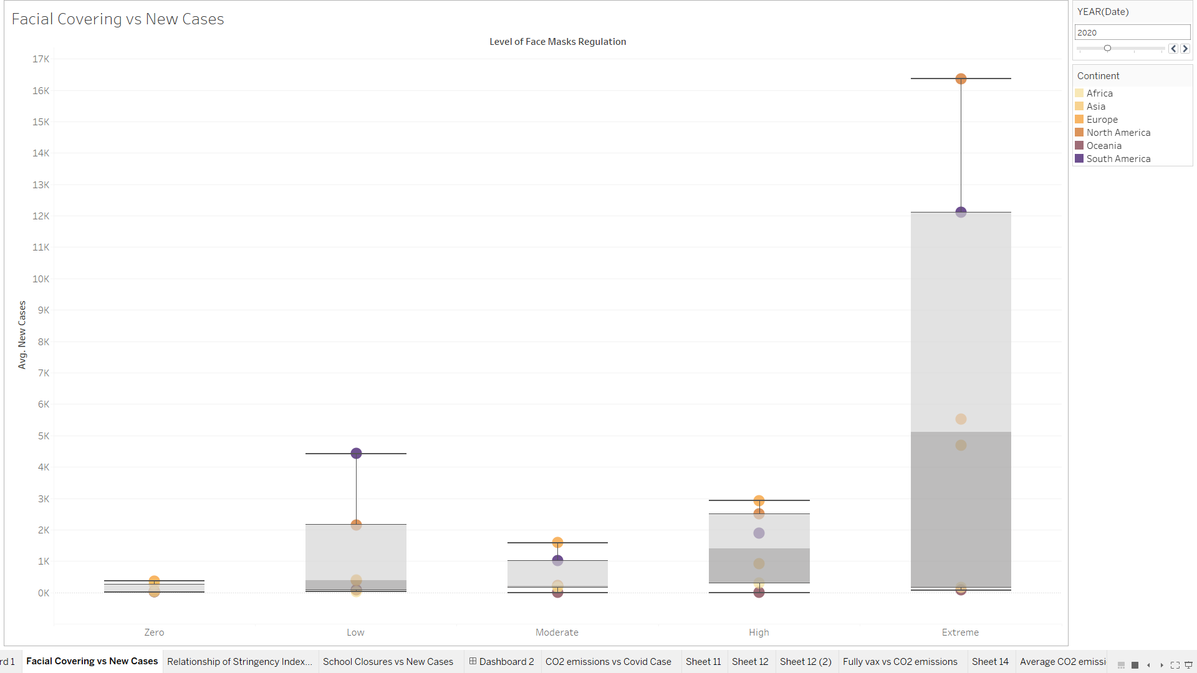
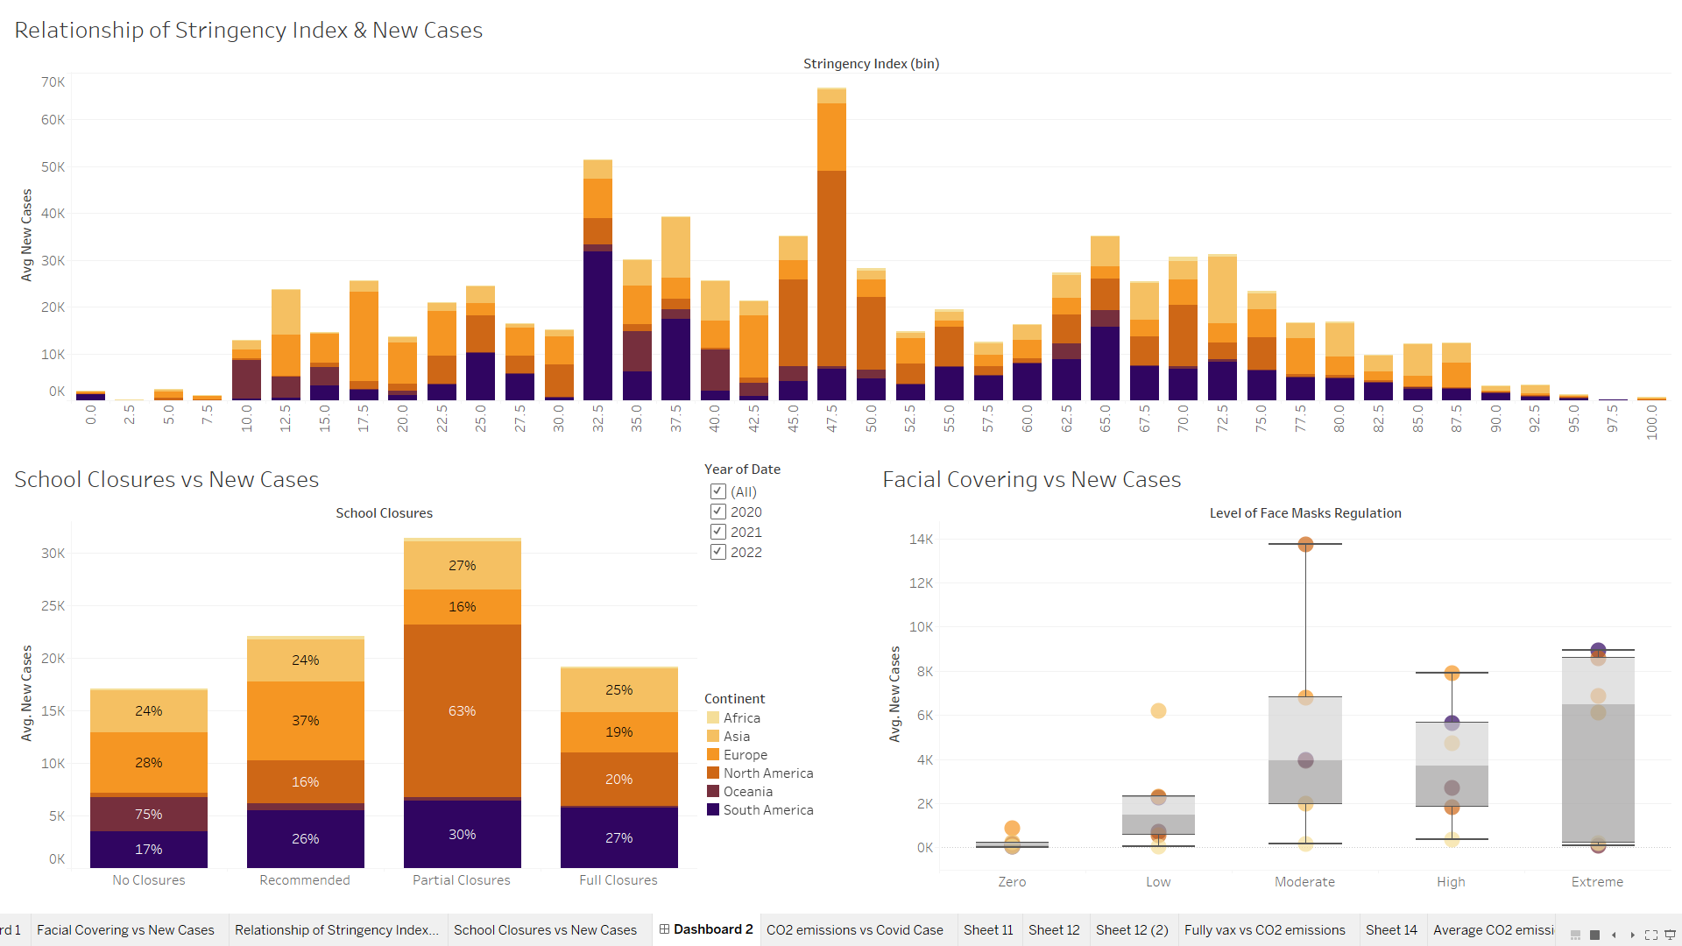
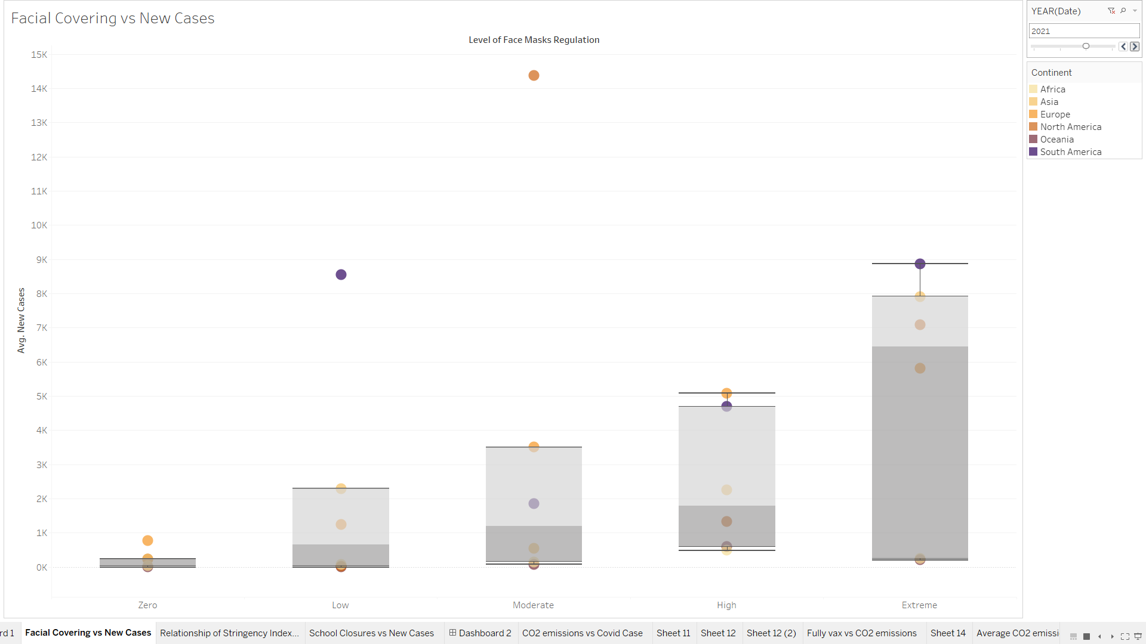
2020 and 2021 Have More Extreme Face Mask Regulation
In 2020 and 2021, countries with high or extreme face mask regulations had the greatest median number of cases.
In 2022, the strictness level of face mask regulations had subsided due to a lower number of cases compared to previous years.
Generally, countries with the lowest median number of cases have zero level of face masks regulations.
Of all continents, Africa had the lowest average number of cases.
2022
2020
2021

Slide 12
Conclusion
Overall, 2021 was COVID 19 peak period globally as it has the highest number of COVID 19 related cases and deaths.
In 2022, COVID 19 cases are improving but still relatively high in certain regions like Europe and North America.
Generally, Africa is the continent with the lowest COVID 19 related case and deaths, possibly due to its high temperature and humidity.
Singapore has one of the lowest mortality rate compared to most countries globally.
Asia is the continent with the highest number of vaccinations, causing it to have a significant lower number of cases.
Strictness of policies depend heavily on the number of COVID 19 cases, the higher the number of cases, the policies are much stricter. It results in a lower number of cases for countries with a high stringency index.
The lower the number of cases, the lower the strictness of the masks and school closures regulations.

Slide 13
Recommendations
2 Things We Have Learnt:
How to obtain useful real world datasets that can help to achieve our objectives effectively
How to clean datasets to obtain only the columns and rows that we plan to use in Tableau
From the trend of the cases and deaths over the years, it shows that January had highest number of deaths. So, the government should be on high alert during this month and take the necessary precautions such as tightening measures against COVID 19 to prevent the high number of deaths from happening.
Overall, Europe and North America are still facing high levels of COVID 19 cases in 2022. This is probably because of the low number of vaccines, compared to Asia which had a lower number of cases because of the high number of vaccines. Hence, European and North American countries should promote their vaccines effectively to their civilians by restating the benefits of being vaccinated using promotion videos and advertisements, which can hopefully result in the decrease of the number of cases in the continents.

Slide 14
Contribution by Team Members
Everyone played a part in every section of the assignment.
Student Name | Percentage of Contribution | Tasks
Tan Wen Tao Bryan | 25% | Dashboard 2, Dashboard 3, pptx
Ryan Yeo | 25% | Data Wrangling, Dashboard 1, pptx
Zachary Leong | 25% | Data Wrangling, pptx, Dashboard 3
Ethan Jedidiah Pang Kin Fong | 25% | Storyboard, pptx, Dashboard 1

Slide 15
References
Dataset Links:
https://ourworldindata.org/covid-vaccinations (Dataset)
https://ourworldindata.org/covid-face-coverings (Dataset)
https://ourworldindata.org/covid-school-workplace-closures (Dataset)
Research Links:
Coronavirus in Africa: Five reasons why Covid-19 has been less deadly than elsewhere, 2021 [online]. Available from: https://gdc.unicef.org/resource/coronavirus-africa-five-reasons-why-covid-19-has-been-less-deadly-elsewhere [Accessed at 8 Dec 2022]

Slide 16
THANK YOU!
Do you have any questions?
yumbuckets05@gmail.com

